Slide 1
“A good visualization is: reliable information; visually encoded so relevant patterns become noticeable; organized in a way that enables at least some exploration, when it’s appropriate; and presented in an attractive manner, but always remembering that honesty, clarity, and depth come first.”
- Alberto Cairo

Slide 2
Visualization Components

Slide 3
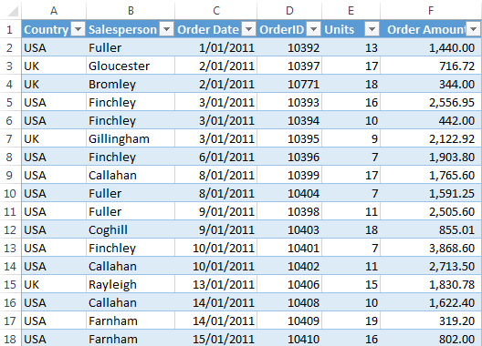
Data
“Factual information (such as measurements or statistics) used as a basis for reasoning, discussion, or calculation” (Merriam-Webster)
“[…] names, amounts, groups, statistical values, dates, comments, locations. Data is textual and numeric in format” (Andy Kirk)

Slide 4
Data Types
Textual - words, may be unstructured
e.g. Comments in a survey
Nominal - mutually exclusive categories
e.g. Names of languages spoken in the US
Ordinal – values that have characteristics of order
e.g. Express shipping vs. Next Day vs. Super Saver
Interval - numerical ranges
e.g. temperature
Ratio – has both properties of difference and scale
e.g. age of survey participants in years

Slide 5
Finding Data: Sources of Open Data Sets
U.S. Data
Data.gov- U.S. Government Data
USA.gov- Data about the U.S. from the Census and other government agencies
Canadian Data
Open Canada/Open Data- Canadian Gov Data
Global Data
CIA World Fact Book - facts and data for 267 world entities
UN Data - produced by United Nations agencies
Google Public Data Explorer- global datasets
Other
Google Big Query Datasets- BIG DATA!
Hathi Trust Datasets- non-google digitized
Subscribed content: JSTOR, Readex, Gale
Cultural Institutions on GitHub

Slide 6
Visual Encoding
Charts
…or graphs, plots, diagrams, maps
Marks
Represents records, can be points, lines, areas, forms.
Attributes
Represents variable values held for each record, can include visual properties like position, size, color, connection

Slide 7
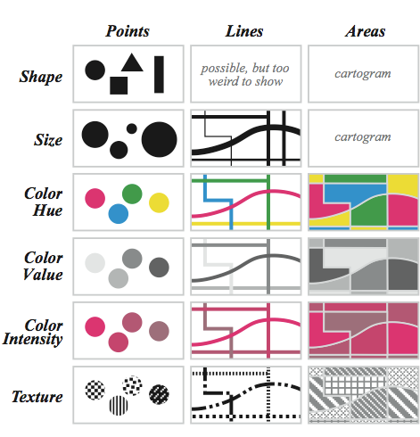
Bertin’s Visual Attributes

Slide 8
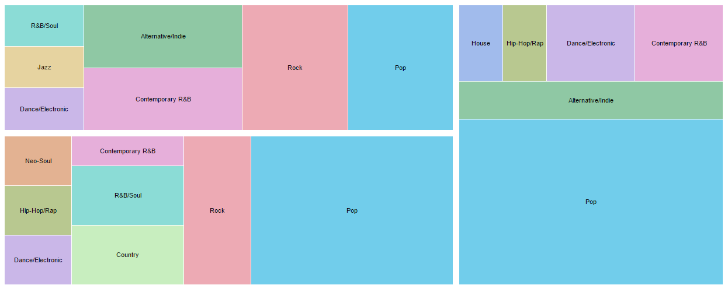

Slide 9
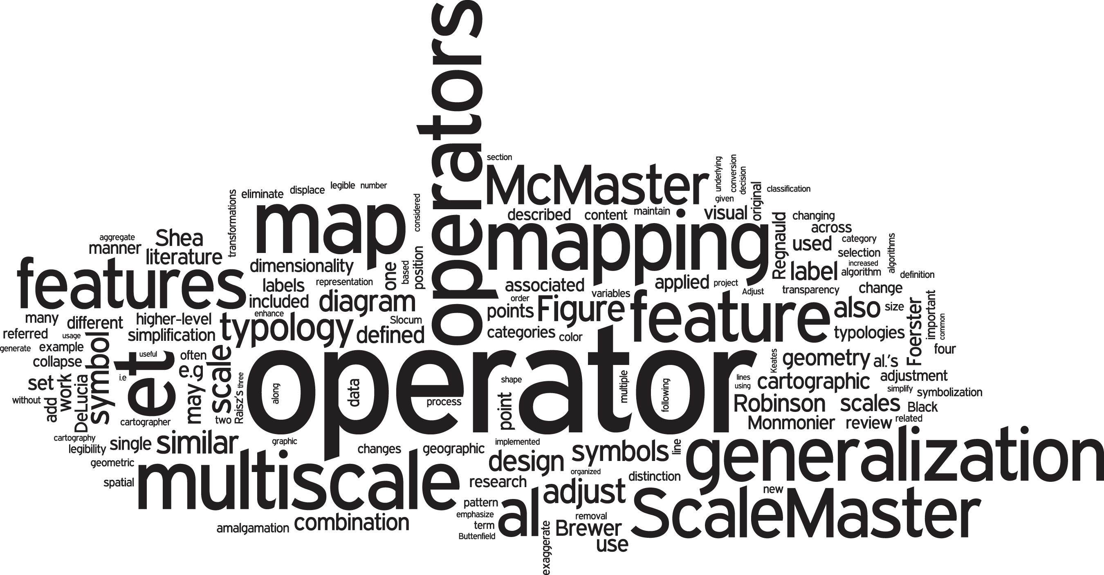

Slide 10
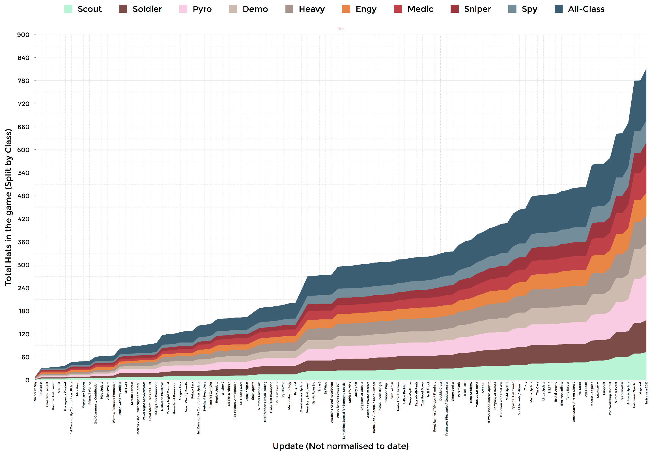

Slide 11
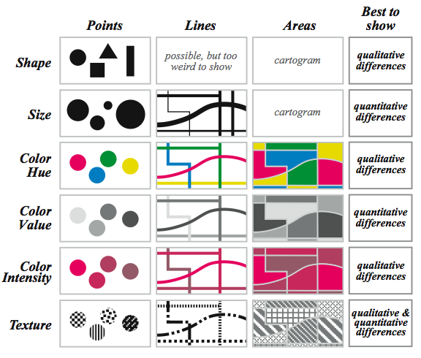
Bertin’s Visual Attributes

Slide 12
Back to Data Types
Are these data types Quantitative or Qualitative
Textual
Qualitative
Nominal
Qualitative
Ordinal
Qualitative
Interval
Quantitative
Ratio
Quantitative

Slide 13
Chart Families & Types

Slide 14
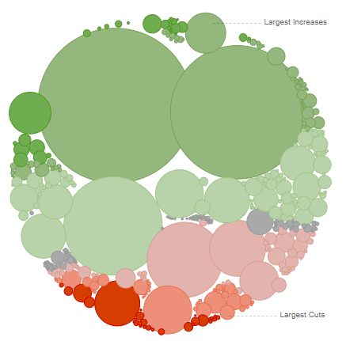
Categorical
Compares categories and distributions of quantitative values
e.g. Bubble chart, Bullet chart, Bar chart

Slide 15
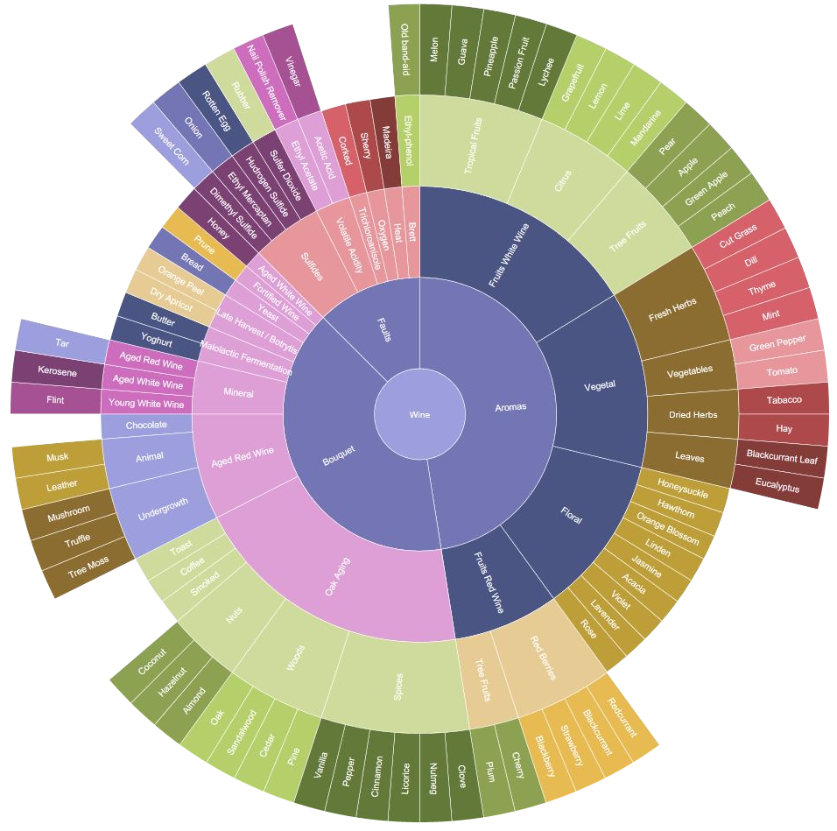
Hierarchical
Charts part-to-whole relationships and hierarchies
e.g. Dendrogram, Ring chart, Tree Diagram

Slide 16
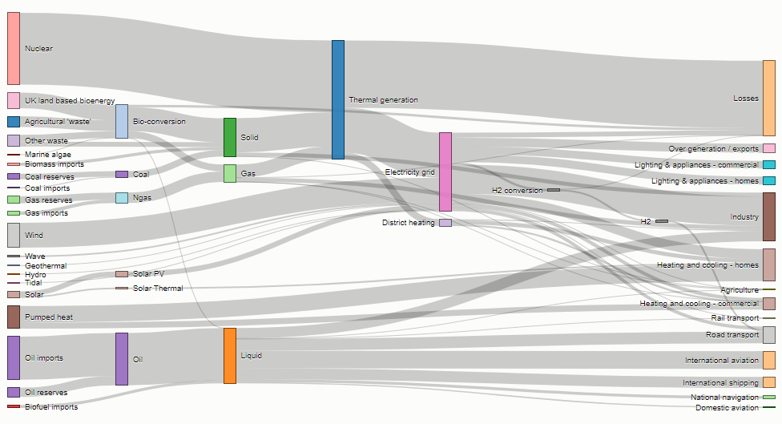
Relational
Graphing relationships to explore correlations and connections
e.g. Sankey Diagram,
Matrix Chart, Heat Map

Slide 17
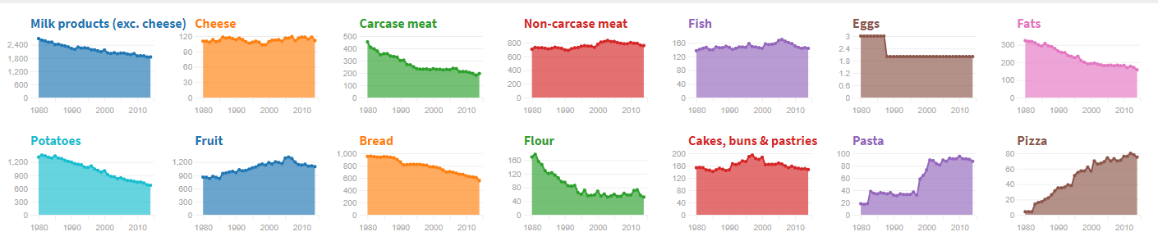
Temporal
Showing trends and activities over time
e.g. Connected scatter plot, Polar area diagram, Time series

Slide 18
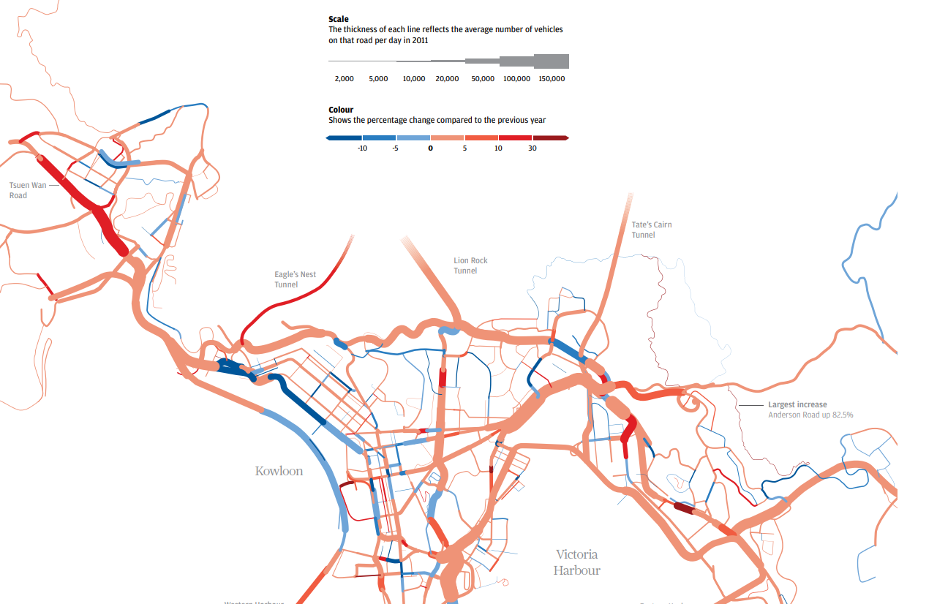
Spatial
Mapping spatial patterns through overlays and distortions
e.g. Prism map, Dot map, Grid map

Slide 19
30 Minute Break

Slide 20
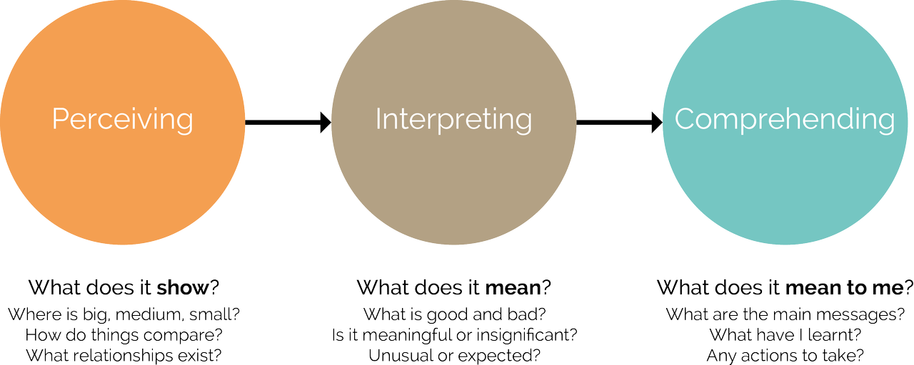
Three Stages of Understanding

Slide 21
Exercise 3
In groups, review your scenario and construct a prototype visualization using paper and markers
What kind of data will you need?
How will you get the data?
What kind of chart lends itself well to your research question? - https://datavizcatalogue.com/
Use any tools you have at your disposal - including the web! Be a librarian!

Slide 22
Visualization Tools and RAW

Slide 23
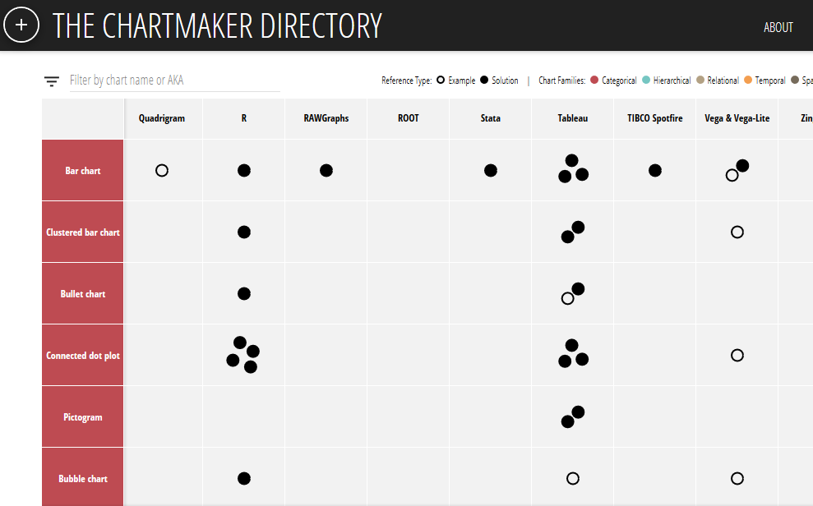
Visualization Tools
Common: spreadsheets (Excel)
Google charts: free, online, basic
Advanced: Tableau
“The Chartmaker Directory is an attempt to gather and organise a useful catalogue of references that will offer an answer to one of the most common questions in data visualisation: 'which tool do you need to make that chart?’.”

Slide 24
RAW Intro
Open source data visualization tool
Online and free to use through your browser
Built on top of D3.js
Allows mapping dimensions of datasets to visual variables of a chart (think marks and attributes)
Customizable dimensions
Ability to export as vector or raster image

Slide 25
RAWGraphs.io

Slide 26
Exercise 4
Choose at least 3 sample data sets in RAWgraphs.io and visualize them in different ways with different charts
Export your charts, give them a unique filename, and upload them to the google drive folder: https://goo.gl/nU9FLQ
What might you learn from these charts?

Slide 27
Final Discussion
Based on your experiences in the class, how do you think Data Visualization can be incorporated in your work now?
If not in your work, should/would you support/promote it?
What resources are available on your campus to support Data Visualization work?

